Slide 1
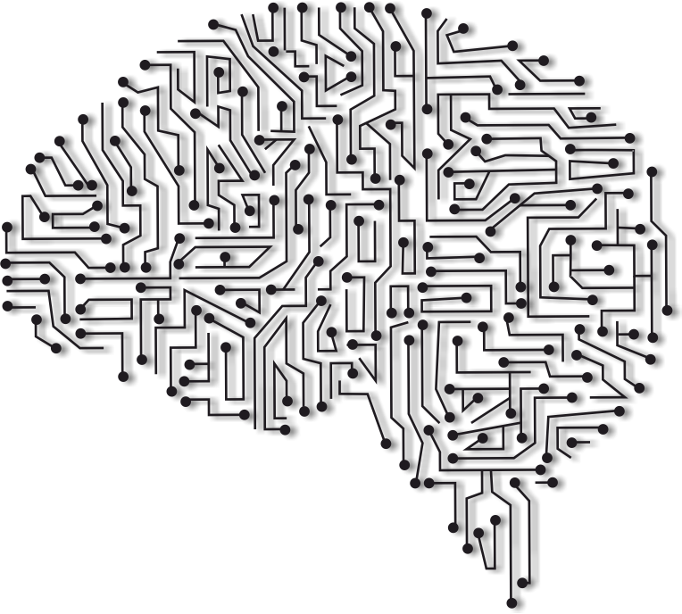
Android Application
For
Handwriting Recognition
Using
Machine Learning
By
M. Mounika(14891A0592)
N. Sai Akhil(14891A0596)
Ch. Goutham Reddy(14891A0577)
P. Nikhilender Reddy(14891A05A0)

Slide 2


